Slide 1
PROBLEM STATEMENT: Employee Tracker. An android application where employees can have all of the basic requirements on their fingertips. Employees can request for leaves, update their profile picture and information, request for knowing the available leaves, and can also provide interview feedbacks (via a simple form in the app itself). The employee should be able to login with his/her own credentials (provided by company) but cannot create new accounts.
PROBLEM STATEMENT NUMBER: PS08
TEAM NAME: Zip Bots
TEAM LEADER NAME: Vikas Dubey
COLLEGE NAME: Indore Institute Of Science and Technology

Slide 2

EMPCARE
Whatever you’re into, Empcare gets job done. By zipbots ps08

Slide 3

Why EMPCARE ?
HYBRID
How it’s different from other applications ?
CONVENIENT
Why it will manage to pull a big userbase ?
COMPREHENSIVE
Why it is the new hub for
Our aim is to provide a comprehensive mobile application
which helps employees to get connected to Daily tasks.
An android application where employees can have all of the basic requirements on their fingertips. Employees can request for leaves, update their profile picture and information, request for knowing the available leaves, and can also provide interview feedbacks. The employee should be able to login with his/her own credentials.

Slide 4

REQUIREMENTS MET
EXECUTION
Need of an app connect the employees of a company.
Features that will provide ease access to employees.
App which focuses on highlighting the leave feature and monitoring the same.
The End Product the user will get will be loaded with a lot features.
Application is dynamic not static. Information keeps getting updated
.
Is fully functional without any bugs
REQUIREMENTS
(IF IMPLEMENTED)
A team of Admins
A team for Database Management

Slide 5
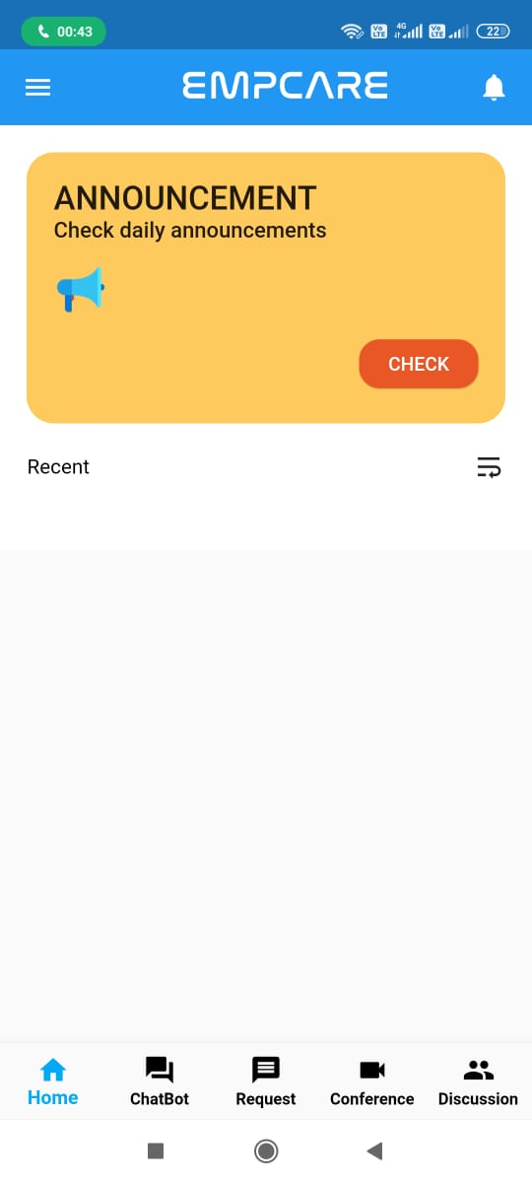
SOLUTION APPEARANCE
& FEATURES
Get notification pallets of upcoming events of the company.
Find Daily task assigned by admin listed accordingly.
Home Tab

Slide 6
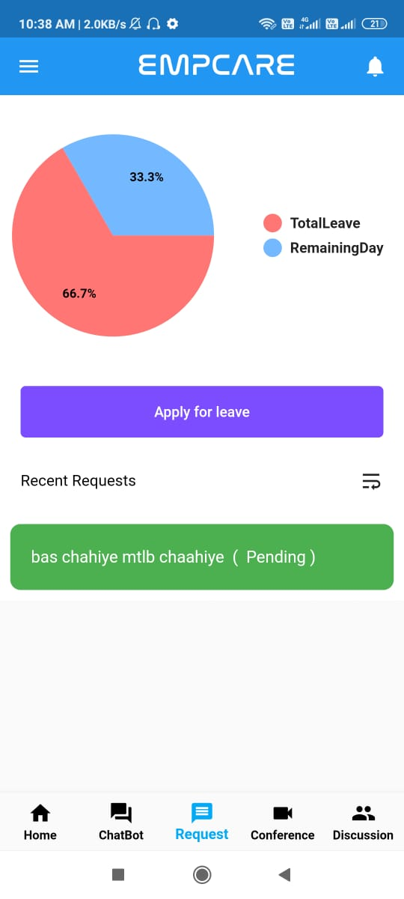
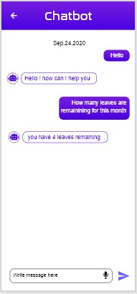
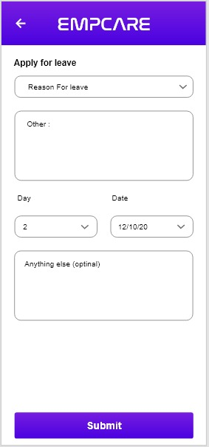
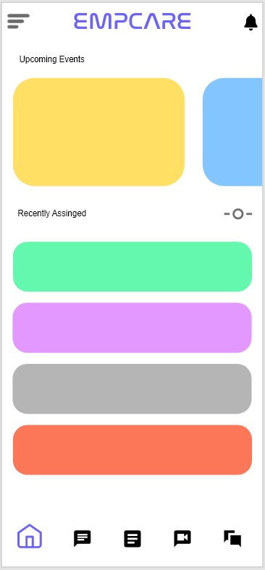
Explore Navigation tabs
Home : to display event pallets and task list
Chatbot : solution of your queries
Leave manager : request for leave and monitor your leaves
Navigation Tabs

Slide 7
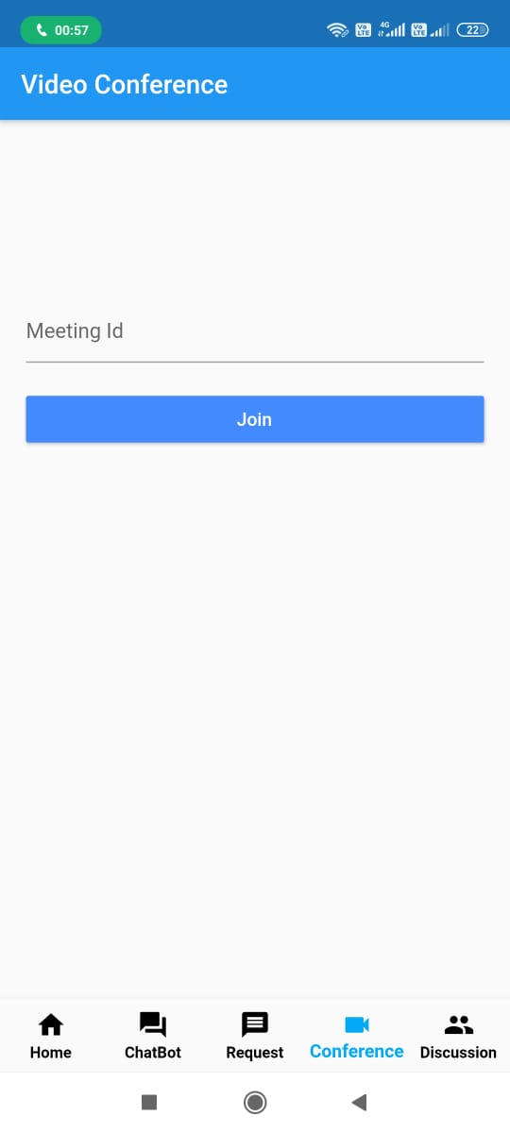
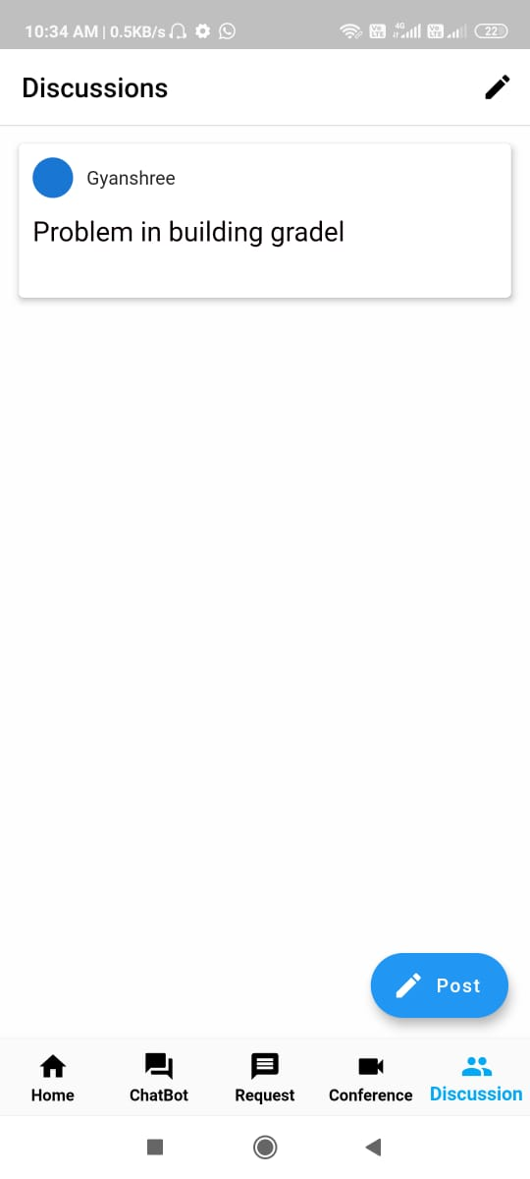
Explore Navigation tabs
Conference : Discuss over voice or video
Discussion forum : Discuss your queries with your colleagues

Slide 8
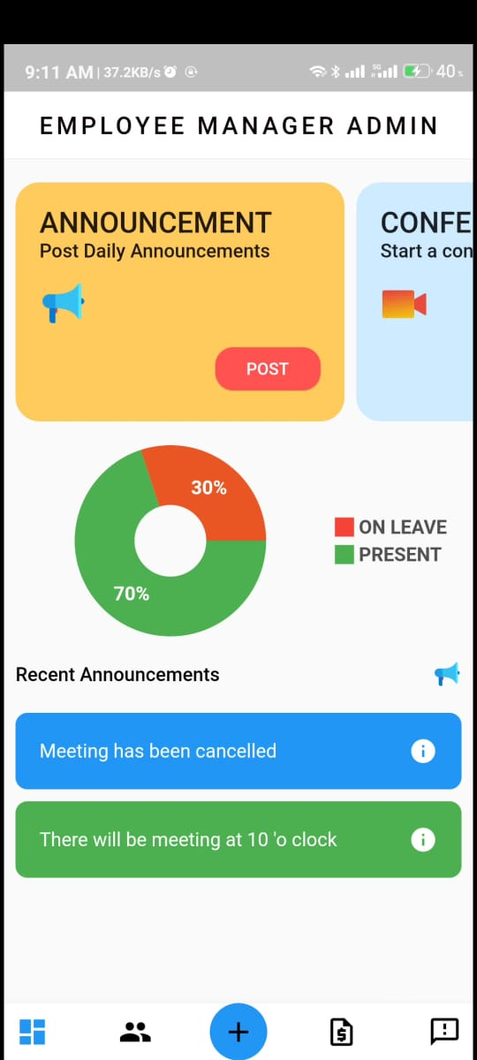
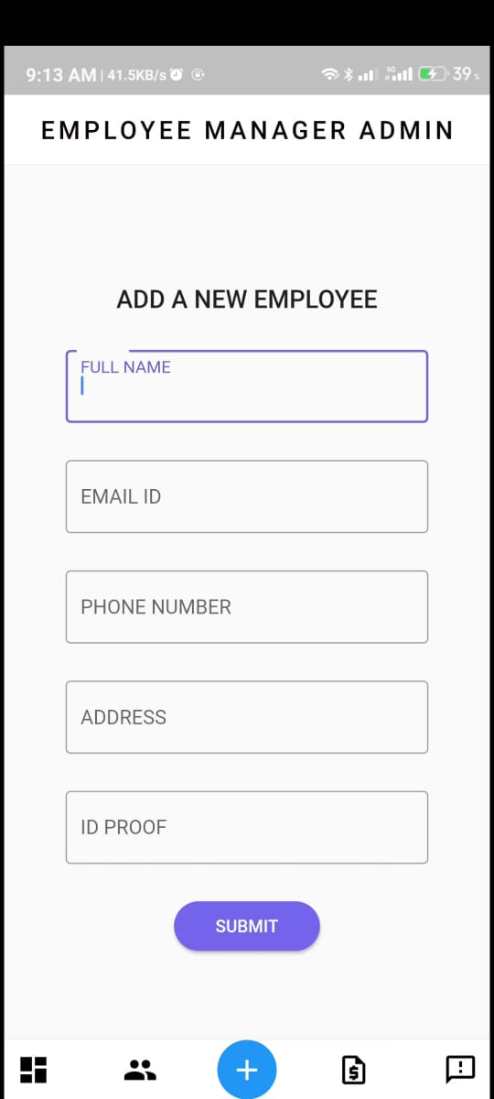
Admin Panel
Assigning new employee
Manage Announcements and Tasks
Arrange Video conference
Handle the leave permission

Slide 9




IMPACT
USER EXPERIENCE
Our application will revolutionize the process of management.
It will empower the process of task assigning and event managing.
Conference with officials via audio or video.
With on-boarding screen, get to know use of every feature
It is built specially for employees.
Feedback is there for suggestions.
UI is designed for ease-of-access
Machine Leaning
TECH
USED
Flutter SDK
Dialogue Flow
Firebase
GITHUB
LINK
https://github.com/SKYLARK-13/Hacksprint_PS08_ZipBots

